Slide 1
New York Education System
By: Elijah Fuller

Slide 2
The DataSet
The dataset can be found on Kaggle https://www.kaggle.com/passnyc/data-science-for-good#2016%20School%20Explorer.csv and was provided by PASSNYC.
The dataset included 1272 schools in the New York City area.
The test scores are from a test called SHSAT, which is a high school admission examination given to students before acceptance into a specialized high school
I also one to mention that the definition used for rigorous instruction is a little different from how I would normally use it and I wanted to clarify their definition. The school dataset provider's definition for rigorous instruction is how well the students were engaged during the curriculum.

Slide 3
More About the Dataset
The shape is 1272 rows (schools) and 161 columns
The dataset intended use is to assist the school system discriminate between which schools needed the most help
There were 3 features that had nearly no data in the columns
Adjusted Grade – 1270/1272
New? – 1243/1272
Other Location in LCGMS – 1271/1272

Slide 5
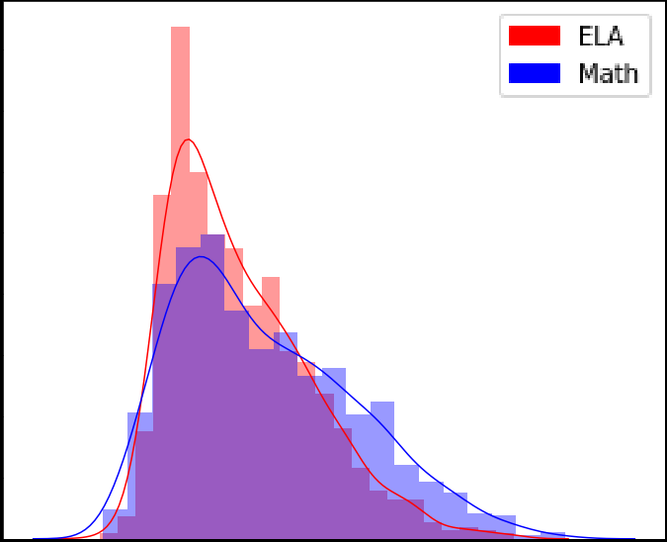
ELA vs Math Proficiency

Slide 8
PCA

Slide 9
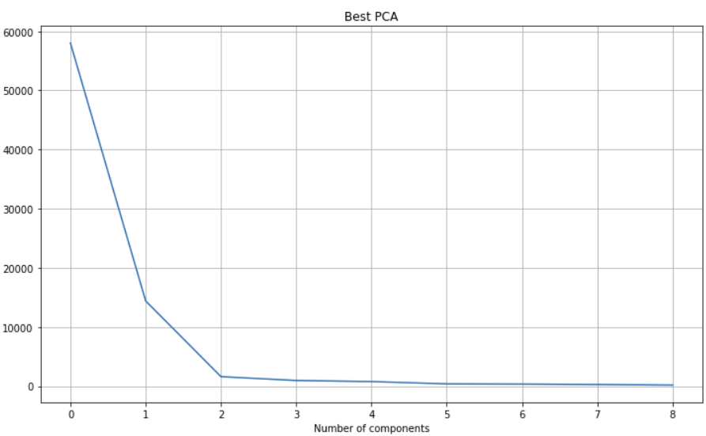
PCA Feature selection

Slide 10
KNN

Slide 11
Logistic Regression

Slide 12
Ridge regression

Slide 13
Lasso Regression

Slide 14
SVR

Slide 15
Random Forest

Slide 16
Gradient Boosting

Slide 17
Best Results

Slide 18
Conclusion

